Slide 1
THE PR TEAM

Slide 2
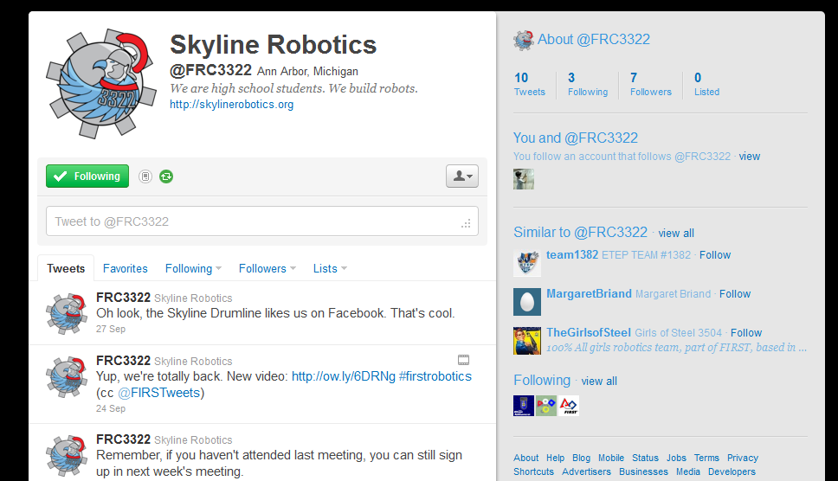
Manage the Twitter page &

Slide 3
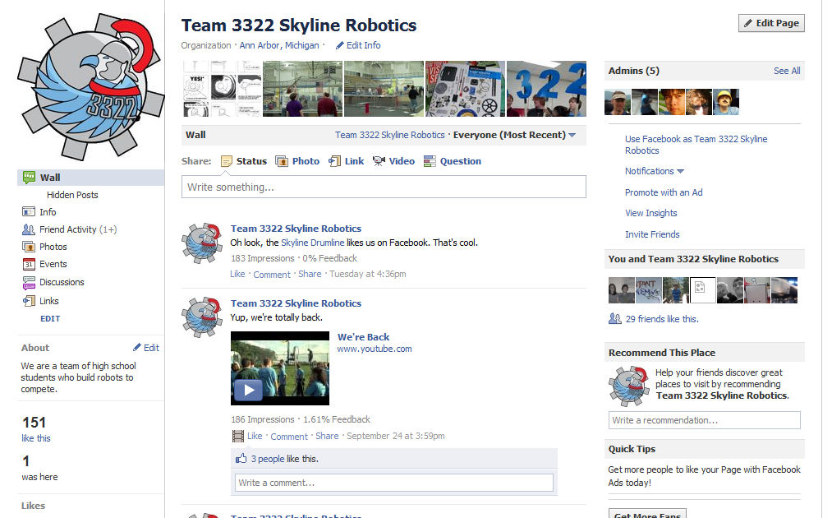
The Facebook Page

Slide 4
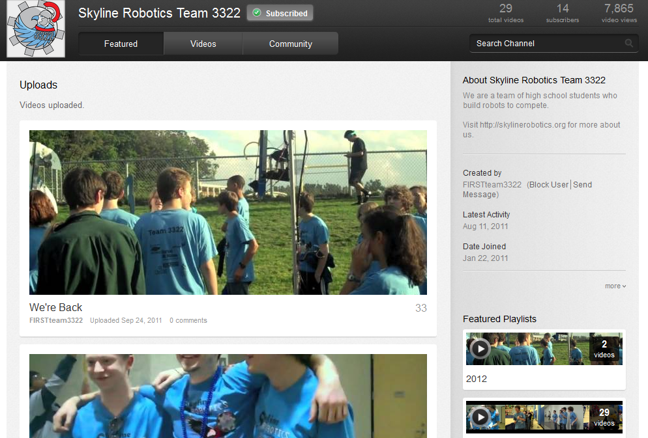
Make Youtube Videos

Slide 5
Create Content for the Website

Slide 6
WHY?

Slide 7
WHY?

